Slide 1
PRADO
Pay attention, this might save you a big headache
ORICCPS@UGR.ES

Slide 2
1. TAP “PRADO” IN GOOGLE
Recomendable entre 120 y 160 cm, mínimo.
2- Espacio libre bajo la mesa
70 cm, para poder moverte, rotar la silla y salir cómodamente de tu puesto.
3- Cajones
Si dispones de cajonera, es recomendable que disponga de ruedas para facilitar la movilidad.
4- Fondo
Debes disponer de un espacio libre para las piernas de 60 cm a nivel de las rodillas y de 80 cm a nivel del suelo.

Slide 3
2. CLICK “GRADO 2024-2025”
Recomendable entre 120 y 160 cm, mínimo.
2- Espacio libre bajo la mesa
70 cm, para poder moverte, rotar la silla y salir cómodamente de tu puesto.
3- Cajones
Si dispones de cajonera, es recomendable que disponga de ruedas para facilitar la movilidad.
4- Fondo
Debes disponer de un espacio libre para las piernas de 60 cm a nivel de las rodillas y de 80 cm a nivel del suelo.
CILCK!!!!!

Slide 4
3. ENTER YOUR EMAIL AND PASSWORD
ENTER YOUR xxxxxx@CORREO.UGR.ES
ENTER YOUR PASSWORD

Slide 5
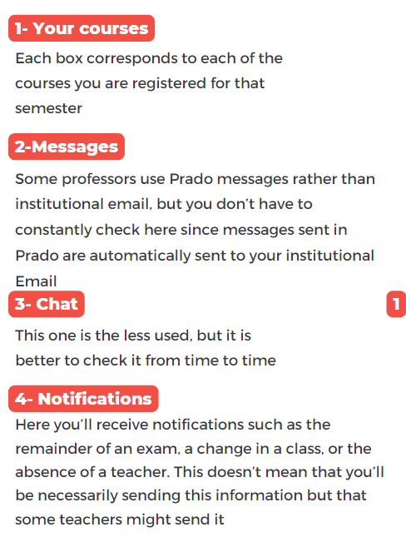
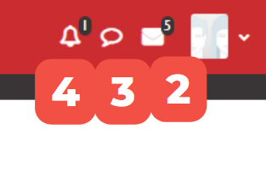
4. IT SHOULD LOOK LIKE THIS
1- Your courses
2
4
Each box corresponds to each of the courses you are registered for this semester
3
2-Messages
Some lecturers use Prado messages rather than institutional email but you don’t have to constantly check here since messages sent in Prado are automatically sent to your institutional email
3- Chat
1
This one is the last used, but better check it from time to time
4- Notifications

Slide 6
2
4
3
1
LET’S CLICK HERE

Slide 7
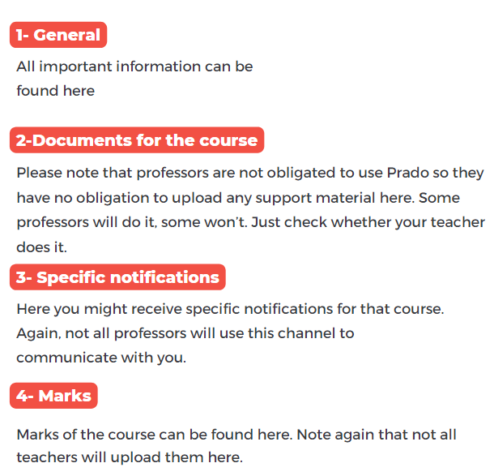
5. THE COURSE
1- General
4
All important information can be found here
3
1
2-Documents for the course
Please note that professors are not obliged to use Prado so they have not obligation to upload any support material here. Some lecturers will do it, some won’t. Just check whether your professor does it.
3- Specific notifications
Here you might receive specific notifications for the course. Again, not all professors use this platform
4- Califications
2
Califications of the course may be found here. Note again that not all teachers will upload them here.

Slide 8
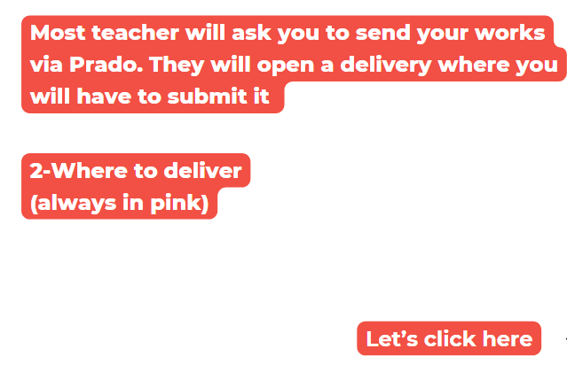
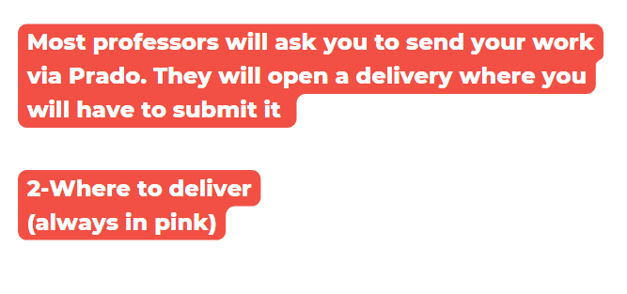
6. HOW TO SUBMIT A DOCUMENT IN PRADO
Most teacher will ask you to send your works via Prado. They will open a delivery where you will have to submit it
2-Where to deliver
(always in pink)
Let’s click here
2

Slide 9
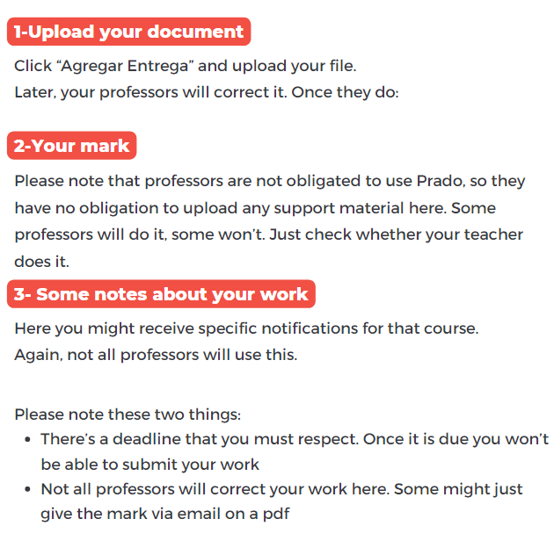
7. UPLOADING AN ASSIGNMENT/ESSAY/WORK
1-Upload your document
Click “Agregar Entrega” and upload your file.
Later your professor would correct it and, once he/she does it:
1
2-Your mark
Remember professors are not obliged to use Prado so they have not obligation to upload any support material here.
3- Some notes about your work
Here you might receive specific notifications for the course. Again, not all lecturers use Prado
2
Please bear in mind two things:
There’s a deadline that you must respect. Once deadline is over you won’t be able to submit your work/essay
Not all professors would correct your work here. Some might just hand the mark via email on a pdf
3

Slide 10
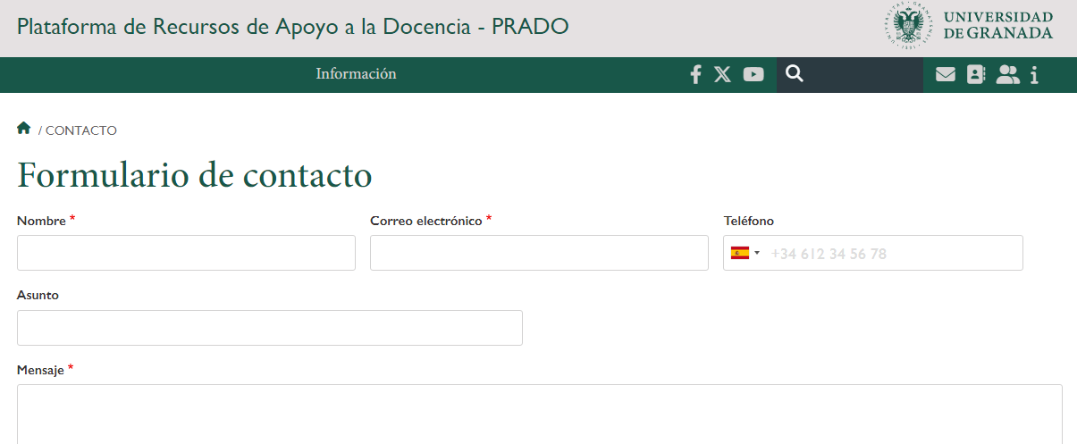
8. A LAST REMARK/WARNING
Bear in mind:
PRADO and Expediente/Matrícula are connected… but not automatically.
Refreshing of any change may take some days
How do things go when you change your courses?
You send us the document of “Hoja de matrícula Changes”
We do the change in your matrícula
You can check in your Resguardo de matrícula through Oficina Virtual that the change is correctly done
BUT…you cannot see the course/s added in your Prado. Well, just a bit of patience, refreshing is done after a few days
Another frequent situation: deleted courses still appear in your Prado…nothing can be done
In any case, there is a link to ask for support: https://prado.ugr.es/contacto

Slide 11
THANK YOU!!
And remember always to ask your Spanish classmate about any issue you may have with Prado, they are used to solve it

