Slide 1
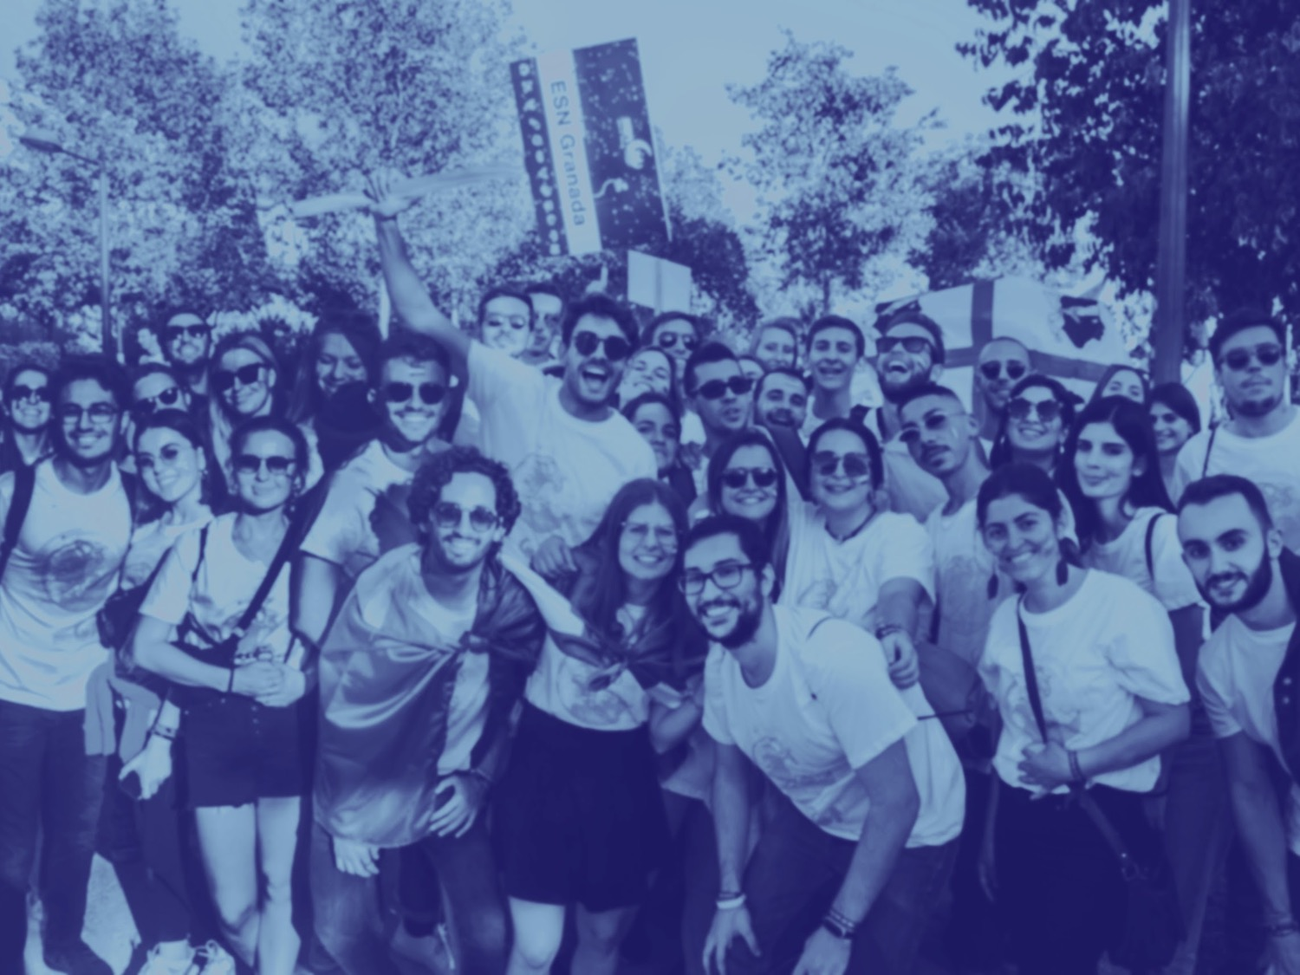
What is ESN?
ESN Granada | info@esngranada.org

Slide 2
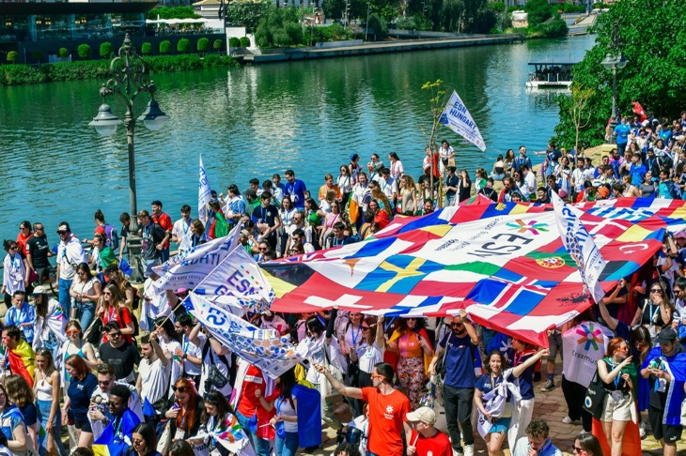
The biggest non-profit student organization in Europe!
519 sections in 45 Countries
15.000 volunteers
We offer our help to over 215.000 students
Students Helping
Students!

Slide 3
What drives us?
ESN Causes
Culture
Education & Youth
Skills & Employability
Social Inclusion
Health & Well-Being
Environmental
Sustainability
Supported by:

Slide 4
What do we do?
Anything to help you out!
Daily activities during our Welcome Days
All sort of events: tours, sports, tapas…
Trips: Integration Weekend, beach trips, National Event Barcelona, ESN Ibiza Trip…
Social Projects
Clubs:
board games, basket, volley, music,hiking…
And much more!

Slide 5
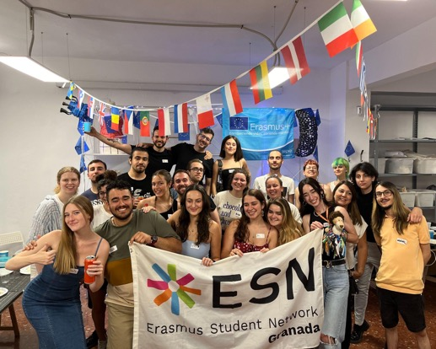
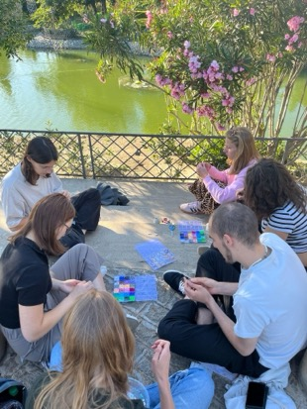
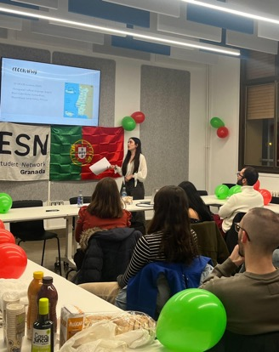
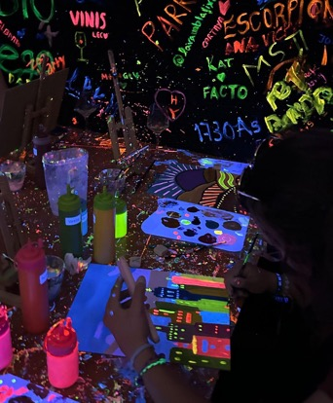
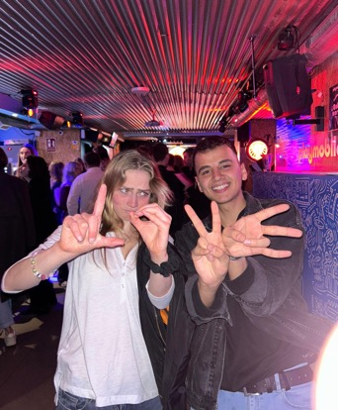
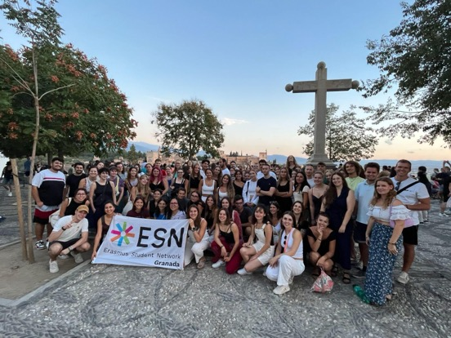
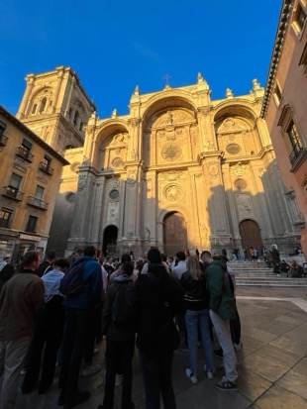
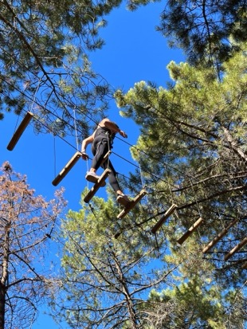
Some of our activities!

Slide 6
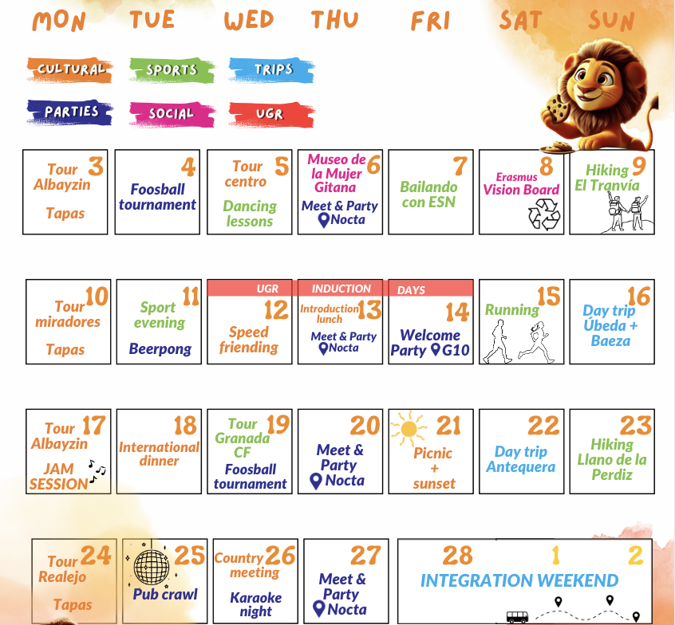
Our Welcome Days calendar!

Slide 7
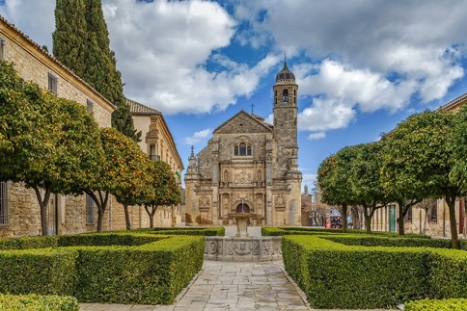
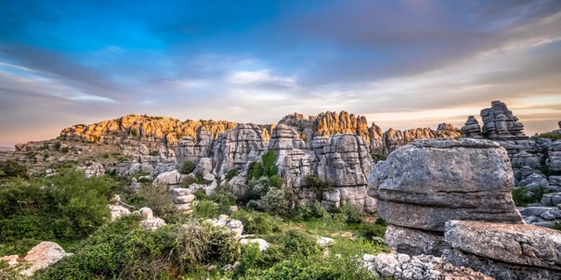
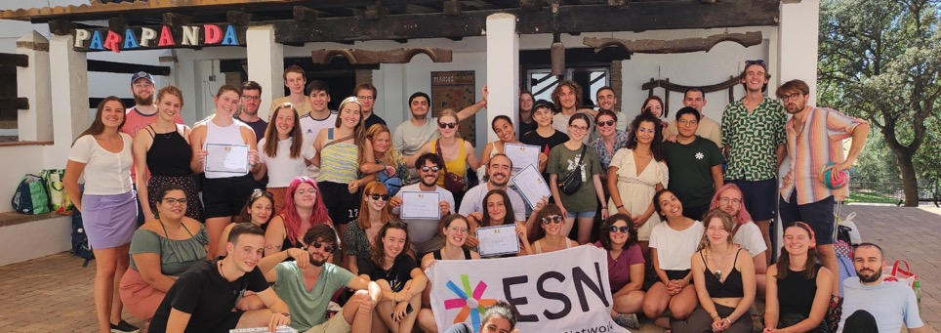
Our upcoming trips!
Úbeda y Baeza
Torcal de Antequera
22nd February
16th February
Integration Weekend
28th February - 2nd March

Slide 8
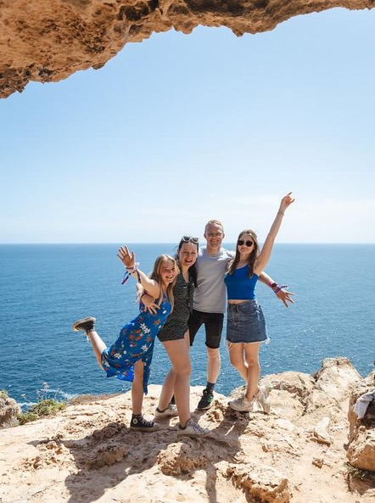
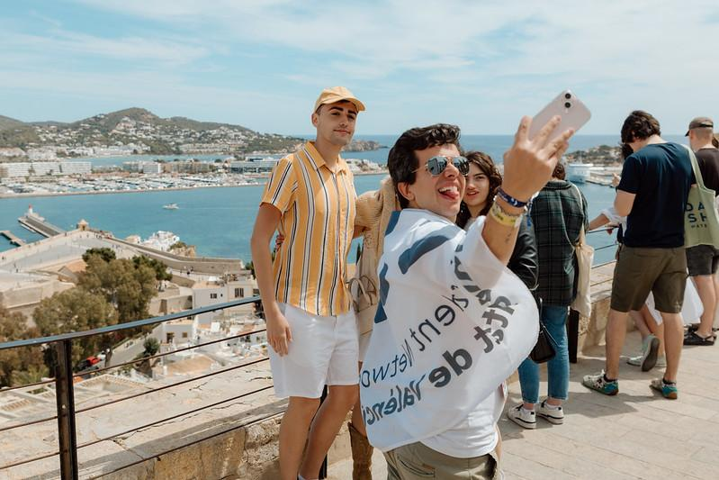
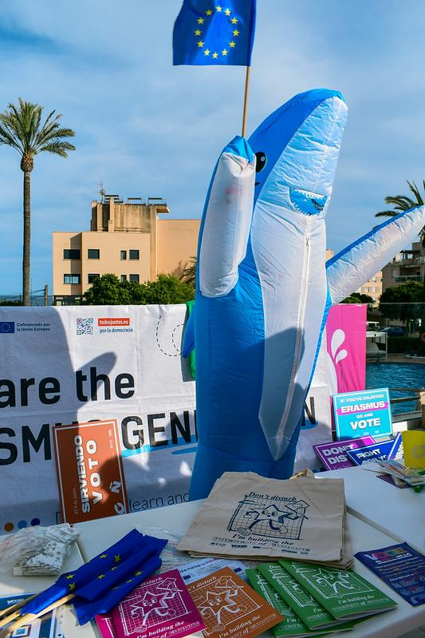
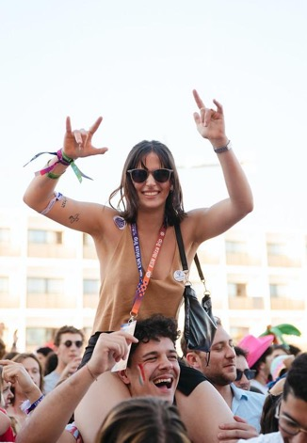
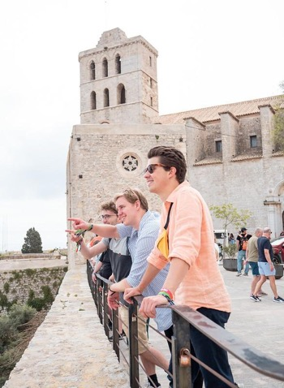
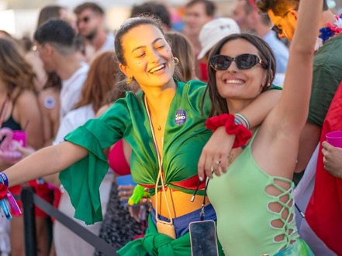
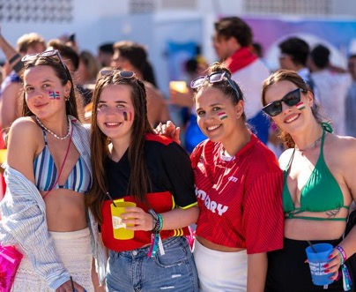
18th-22nd April
Save the date!

Slide 9
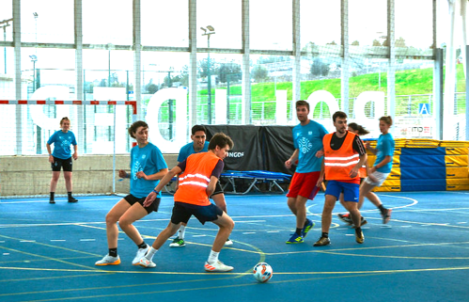
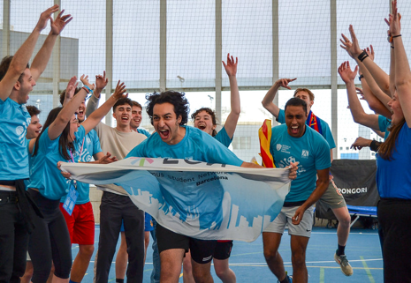
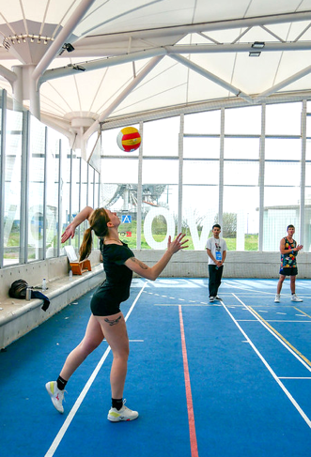
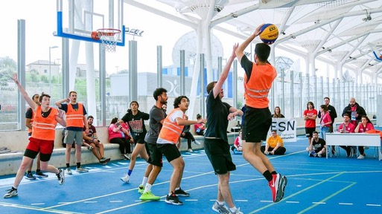
You may also enjoy…
National Erasmus Games (NEG) Toledo

Slide 10
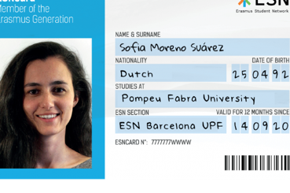
Come to our office and get your ESNcard!
Use many discounts from our partners all over Europe and use it to join our trips!
It’s located in Facultad de
Caminos, Canales y Puertos
(Floor -1), Fuentenueva Campus
Opening hours:
Tuesdays and Thursdays
from 18:00 to 20:00
Wednesdays and Fridays
from 11:00 to 13:00

Slide 11
International & national discounts

Slide 12
Local discounts
& more!

Slide 13
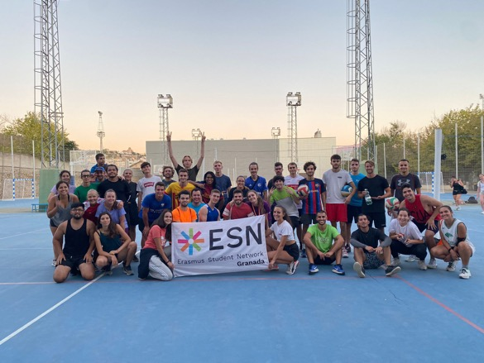
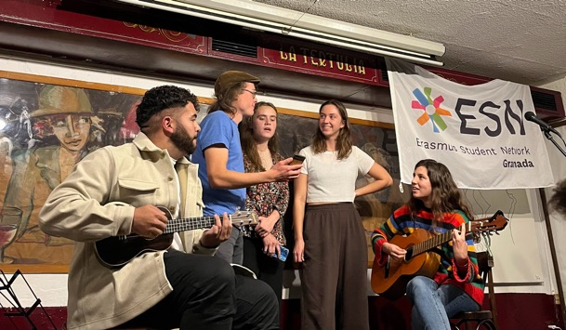
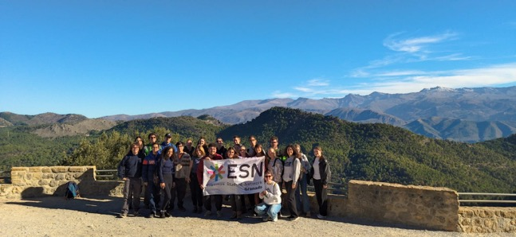
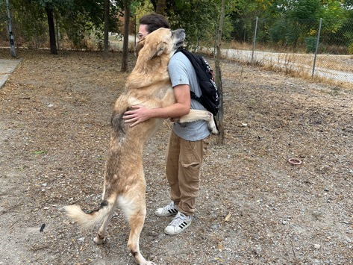
ESN Clubs
Sports Clubs
Erasmusicians
SocialErasmus

Slide 14
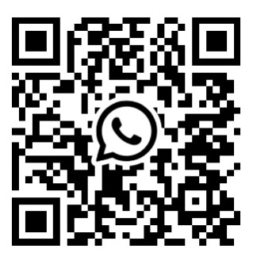
Join our WhatsApp group to stay tuned!

Slide 15
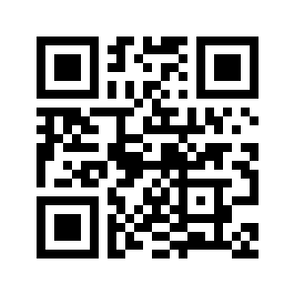
You can also follow us on social media!
@esngranada
ESN Granada
www.esngranada.org
Find out more!

